Slide 1

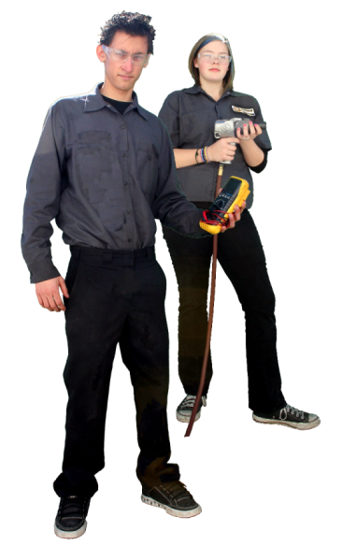
FAST Academy
FALCON ACADEMY of SUSTAINABLE TECHNOLOGIES

Slide 2
Common Core and CTE: Making it Work
Palmdale High School FAST Academy

Slide 3
The challenge
Common Core is coming!
Notes:
Megan- discuss Common Core standards and how it is a natural fit for CTE classes

Slide 4
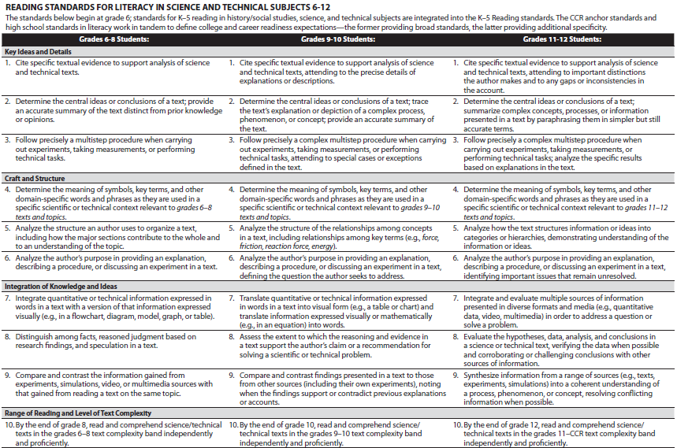
Does this seem a little overwhelming?

Slide 5
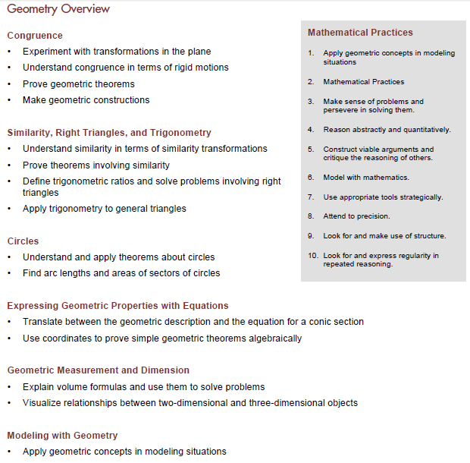
What about this?

Slide 6
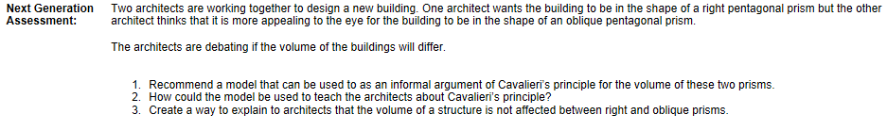
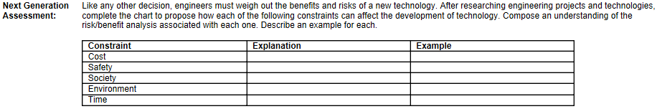
…and they’re going to have to do this??
Math
ELA

Slide 7
The challenge
How do we prepare our students for the new challenges they will face?
Notes:
Megan- discuss Common Core standards and how it is a natural fit for CTE classes

Slide 8
Our solution
We created a performance task-type project that required our students to take knowledge gleaned from…:
    Math classes
    Science classes
    CTE classes
    Their own research
…to find a solution to a complex problem.

Slide 9
The planning process
Step 1: Deciding on a way to tie in multiple subjects in one project
  Used “The Masque of the Red Death” as a launch point
Step 2: Working with the team to determine which subjects worked best for our student population and cohorting
  Biology
  Geometry
  CTE (of course!)

Slide 10
The planning process
Step 3: Determining how the students would work on the project and what the final product would be
Step 4: Creating a problem for the students to solve
Step 5: Putting together the materials we would need to execute the project

Slide 11
What the students saw

Slide 12
FAST Academy
Disease Project

Slide 13
What is it?
The Disease Project is a project that will ask a lot of you. You will be required to gather information in multiple classes and work together as a team to solve a problem.

Slide 14
How will it work?
You will be working in groups to solve a problem. Once you have solved the problem, you will be required to create a PowerPoint (or Google) presentation with your solution.
ELA SPEAKING AND LISTENING STANDARDS 6-12
Presentation of Knowledge and Ideas
5. Make strategic use of digital media (e.g., textual, graphical, audio, visual, and interactive elements) in presentations to enhance understanding of findings, reasoning, and evidence and to add interest.

Slide 15
What next?
Once your group has solved the problem and figured out a solution, you will present your findings to your academy peers and a panel of teachers, who will grade your presentation.
ELA SPEAKING AND LISTENING STANDARDS 6-12
Presentation of Knowledge and Ideas
4. Present information, findings, and supporting evidence clearly, concisely, and logically… such that listeners can follow the line of reasoning and the organization, development, substance, and style are appropriate to purpose…, audience, and task.

Slide 16
Who’s involved?
All of these teachers will be working on this project with you. You will have at least some of them.
  Mr. Rodriguez
  Mr. Green
  Mrs. Andrews
  Mr. Andrews
  Mrs. Bookman
  Mr. Harris

Slide 17
Problems?
You will need to share resources. Not every group has members in every class. You will need to figure out who has which teachers, and that person will be responsible for bringing back the parts of the project that the teacher presents.

Slide 18
Problems?
The FAST Academy computer lab will have teachers available for help on certain days. Ask any of the involved teachers if you need help, and they can tell you which days the lab will be open for help.

Slide 19
This is YOUR project
WRITING STANDARDS FOR LITERACY IN HISTORY/SOCIAL STUDIES, SCIENCE, AND TECHNICAL SUBJECTS 6-12
Research to Build and Present Knowledge
8. Gather relevant information from multiple authoritative print and digital sources (primary and secondary), using advanced searches effectively; assess the usefulness of each source in answering the research question; integrate information into the text selectively to maintain the flow of ideas, avoiding plagiarism and following a standard format for citation.
It is up to you to solve the problem you are presented with. The teachers around you will offer support and the necessary information, but it is up to you to put it together in a way that works and create a presentation for the group.

Slide 20
What to anticipate:
The FAST Academy has reserved the mall after hours for a special event. Three hundred students from the academy attend the event, as well as several adults. Most of the adults have stepped outside for a short time, and everybody is having a good time. Then tragedy strikes…

Slide 21
What to anticipate:
After a frantic 911 call to report the incident, the CDC is notified that there may be a dangerous health situation and orders the facility locked down under quarantine. Nobody can go in or out until the CDC determines that there is not a threat to the general public. There are now 300 students trapped in the mall indefinitely.
In order to help everybody cope with the situation and not panic, you must decide what actions to take. Your team needs to work together to create a plan for handling the situation. You will present your information to your fellow students in order to reassure them and convince them to work together to get through the crisis.

Slide 22
What to anticipate:
LANGUAGE STANDARDS 6-12
Vocabulary Acquisition and Use
6. Acquire and use accurately general academic domain-specific words and phrases, sufficient for reading, writing, speaking, and listening at the college and career readiness level; demonstrate independence in gathering vocabulary knowledge when considering a word or phrase important to comprehension or expression.
In your presentation,
you need to:
Identify the illness
(based on symptoms):
  Name of disease
  Mortality rate
  Transmission path
  Incubation period
  Infection agent (virus, bacteria, etc.)
  Preventative measures

Slide 23
What to anticipate:
Mathematics- Standards for mathematical processes
4 Model with mathematics.
By high school, a student might use geometry to solve a design problem or use a function to describe how one quantity of interest depends on another. Mathematically proficient students who can apply what they know are comfortable making assumptions and approximations to simplify a complicated situation, realizing that these may need revision later.
Calculate the following:
  How long the quarantine will need
  to last to ensure that there is no
  threat to the public
  Number of expected infections
  without preventative measures
  Number of deaths without
  preventative measures
  Number of expected infections
  with preventative measures
  Number of deaths with
  preventative measures

Slide 24
What to anticipate:
Modeling with Geometry
Apply geometric methods to solve design problems (e.g., designing an object or structure to satisfy physical constraints or minimize cost; working with typographic grid systems based on ratios).
  How will 300 people live in the mall
  for the duration of the quarantine?
    Work out how you will meet the needs
    of all the people who are there.
  How will you use the space and/or
  materials available to you?
  How will you deal with and house the sick
  and dead?
    How much space do you need?
  What facilities will you need to deal with this situation?
  What environmental systems do you need to consider? How will you use them?
Project Lead the Way
Introduction to Engineering Design (IED)
…Through hands-on projects, students apply engineering standards and document their work.

Slide 25
Basic information
Assume a 75% infection rate for those exposed to contagious illnesses. For the sake of this project, the timelines between onset of significant symptoms and final outcomes may have been accelerated. All presenting symptoms are accurate. You will have access to expert guidance if you ask the right questions of the right people. You will have sufficient supplies available to see you through the quarantine time if you use them well.

Slide 26
Subject-specific lessons

Slide 27
Biology

Slide 28
Universal Precautions

Slide 29
Universal Precautions
All blood and potentially infectious materials are treated as of they are infectious, regardless of the perceived status of the source individual.
You treat all blood and body fluids as if they are infected.

Slide 30
Universal Precautions
Wear gloves
Launder contaminated clothing
Wash hands
Avoid sharing food, drink, contact lens, cosmetics, lip balm
Clean up
Report incident

Slide 31
Other Precautions
Masks
Safety glasses or goggles
Quarantine Infected patients
Full Hazard suits

Slide 32
Diseases
Some diseases are produced by bacteria, viruses, or fungi.
Others are caused by materials in the environment, such as cigarette smoke.
Still others, such as hemophilia, are inherited.

Slide 33
Pathogens that can cause disease include:
viruses
bacteria
protists
worms
fungi

Slide 34
Types of Transmission
  Some infectious diseases are spread from one person to another through coughing, sneezing, or physical contact.
  Other infectious diseases are spread through contaminated water or food.
  Still others are spread by infected animals.

Slide 35
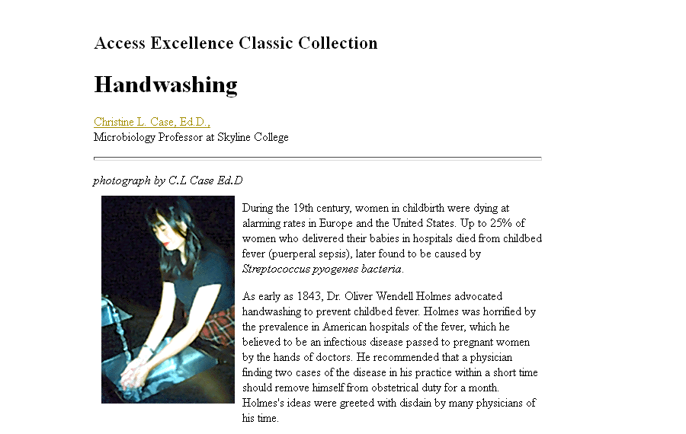
Handwashing Article

Slide 36
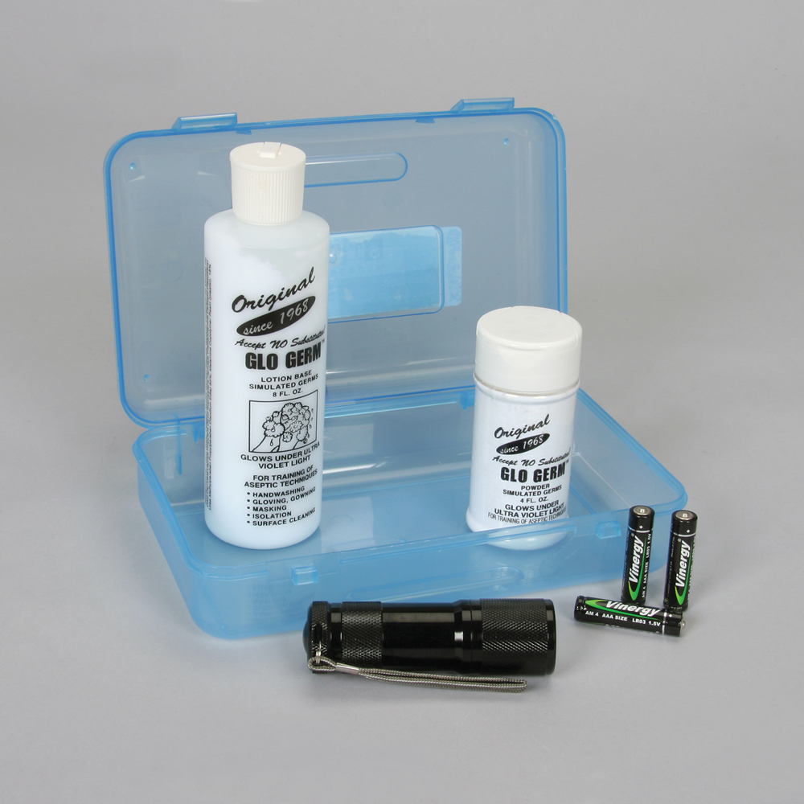
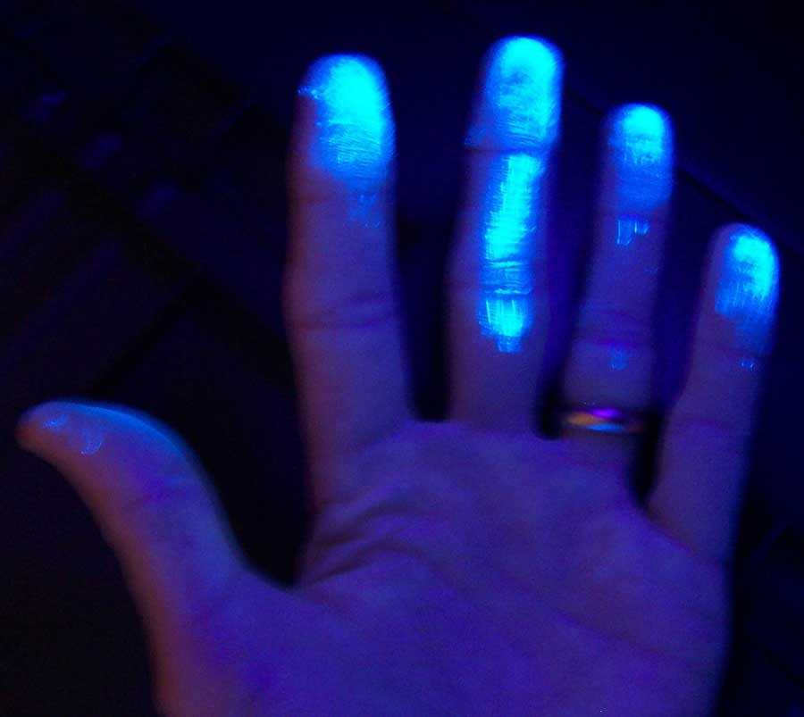
Handwashing Activity

Slide 37
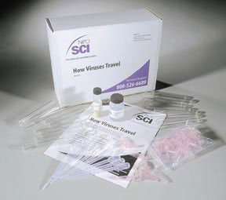
Transmission of Disease Activity

Slide 38
Video clips that may add interest or additional background knowledge:
Mythbusters: “Flu Fiction”
Hot Zone (ebola)
Outbreak (ebola-like virus)
House: "A Pox on Our House“ (smallpox threat)
ER: “Lockdown” (smallpox threat)
Bones: “The Man in the Fallout Shelter” (protective protocols)
NCIS: “SWAK” (pneumonic plague)

Slide 39
Math

Slide 40
Geometry

Slide 41
Calculate Volume of Stores in the mall
Height
Width
Length

Slide 42
Assumed Values
Each store has a height of 10 feet
Small stores assumed to have 1500 sq ft

Slide 43
Air Exchange
Assumed exchange is between 6 and 10 times per hour.

Slide 44

Personal Space
Just how much space will the average person need?

Slide 45
Pathway

Slide 46
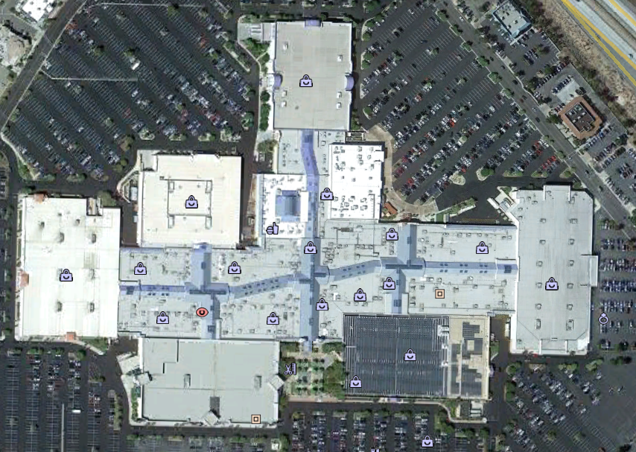

Slide 47
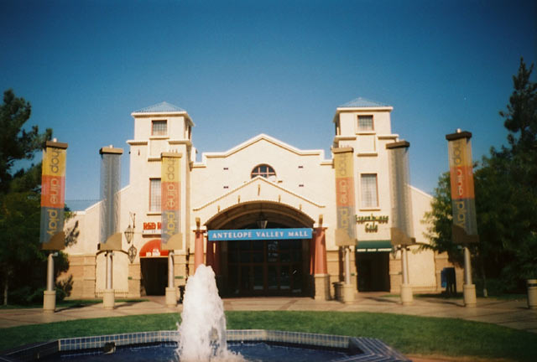
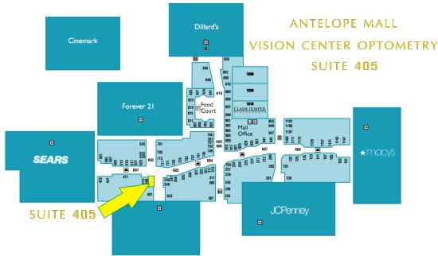


Slide 48
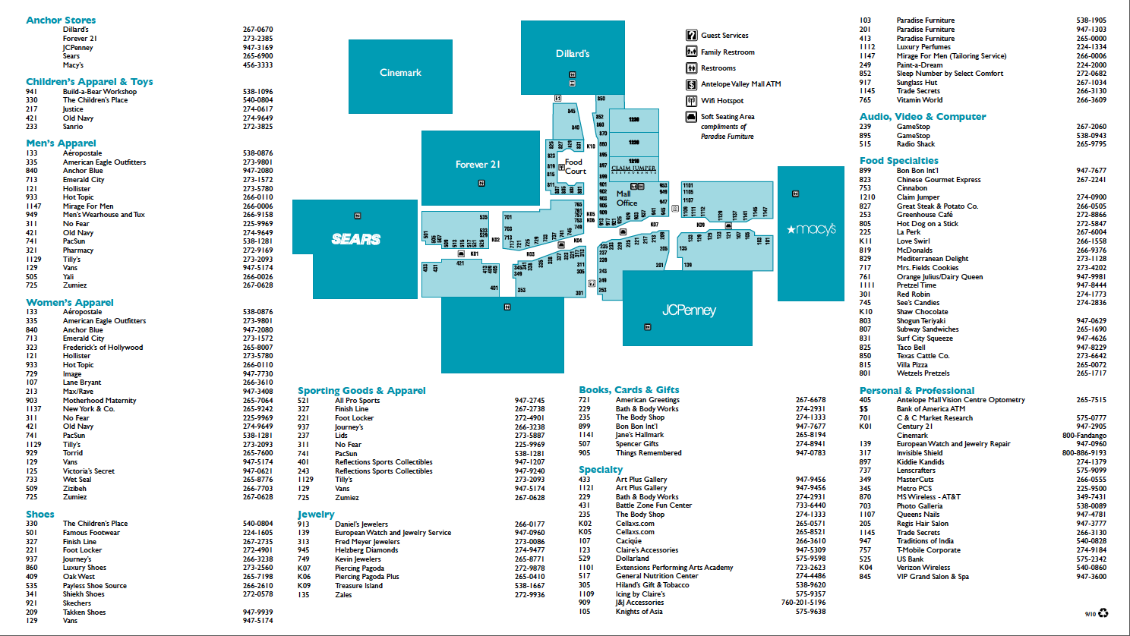

Slide 49
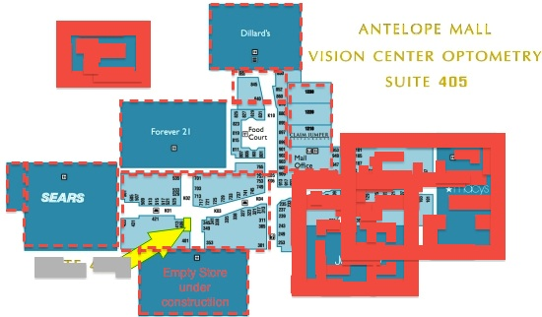

Slide 50
Material in the Store Under Construction
Quantity | Description
50 | 1/2' MDF Sheets 4'x8'
500 | 5/8" Drywal Sheets 4'x8'
160 | 1"X 6"X 8' Pine Boards
80 | 1"X 4"X 8' Pine Boards
500 | 1-1/2"x3-1/2 Steel Studs
100 | 1-1/2"x3-1/2 Steel Track
100 | 1-1/2"x3-1/2 Studs
5 | Rolls of Plastic (6 mi)l 12'x500'
5 | 1 Lb Box 1-1/4" Screws
5 | 1 Lb Box 2" Screws
5 | 1 Lb Box 2-1/2" Screws
5 | 1 Lb Box 3" Screws
5 | 1 Lb Box 1/2" Modified Truss Head Screws
5 | 1 Lb Box 3/4" Modified Truss Head Screws
5 | 1 Lb Box 1" Modified Truss Head Screws
1 | 50 lb Box of 8d Nails
1 | 50 lb Box of 16d Nails
1 | 1 Lb Box 1-1/2" Modified Truss Head Screws
12 | 1-7/8 Combo Locks
2 | 1 Gal Wood Glue
1 | Case of Caulking

Slide 51
Student results
Clip from presentation
Disease scenario:
  A teacher has stayed inside watching over the students while the rest of the adult chaperones stepped outside for some fresh air. He suddenly began coughing while talking to a group of 5 students. One of those students went over to the snack bar, where 5 students were waiting, cuts to the front, brushing by everyone waiting in line, to get a bottle of water for the teacher that was coughing. The student runs back with the water, but finds that the teacher is coughing up frothy, bloody sputum. Suddenly, he passes out. When a student checks on him, he discovers that the teacher has a fever and is having difficulty breathing. While moving the unconscious teacher to a more private area, four students notice that the teacher has quit breathing. When they arrive at a doorway of a nearby store two students go back to the area where coats and other belongings are stored to get their cell phones and call for help, while two students stay and attempt CPR on the teacher, but have no success.

Slide 52

The pneumonic plague
Group 6
Amber Alcala Brian Gallegos
Edgar Lopez Salvador Sanchez
Kevin Fletcher Tristan Villanueva

Slide 53
What is the Pneumonic Plague?
A bacterial disease that was found in many countries, reports of a sudden "Black Plague" like disease reported from China all the way to Peru
1998-2009 nearly 24,000 reports have been recorded, including 2,000 deaths in Africa, Asia, America(North and South), and Eastern Europe
This disease is one of three types of lung infections that is caused by a bacterium called Yersinia Pestis, this disease is rare, more than its sister disease, the Bubonic Plague
This disease can be transmitted by the air around the patient or by breathe(in this case mouth to mouth)

Slide 54
The Mortality Rate
The Mortality Rate of this disease is massive. It is spread by the air we breathe, it can spread like a wildfire "Advised to take precaution when around a patient with this disease"
When infected, you only have a 24 hour time limit to be treated, antibiotic treatment is available, if not properly treated in the 24 hour treatment window, the fatality rate of the Pneumonic Plague will approaches 100% chance of death, or passing of the disease on to another person
Incubation Period is 2 to 4 days(range 1 to 6 days)after exposure
This disease is categorized as a bacterial infection since it is formed by the Y pestis(Y standing for Yersinia)

Slide 55
The Mortality Rate
There is a 66% chance of a mortality rate can happen if the host is not treated with anti-bodies
The mortality rate if the host is treated with anti-bodies is only 11%
What does this mean?
66% times how many are infected (18 people at least) and that would give you a total of 11-12 people that for sure are dead.11% mortality rate would be at least 1-2 people that are as good as dead

Slide 56
What are The Symptoms?
Early symptoms(2-5 days of exposure) are: chills, fevers, coughing, muscle aches, and headaches
Later on symptoms(2-3 days after exposure) are: chest pains, trouble breathing, and hemoptysis(coughing blood); nausea, vomiting and abdominal pain may also occur(it is a 60% chance that these symptoms may occur)

Slide 57
Ways to Avoid/Quarantine the Disease
There are safety protocols to avoid obtaining the disease "one way to prevent you from obtaining the disease is simply avoid contact from the patient, wear a doctor's mask so that the air you breath in will not carry the bacteria(or you can just wear a Hazmat suit), WASH YOUR HANDS!!!(why just for the heck of it), you can quarantine the patient in a bubble like room for your safety(only if you and the patient agree, if not agree to disagree)"
If you do NOT follow at least some safety procedures then you have a 1/50 chance that you will not get infected with the disease

Slide 58
PLANS FOR THE MALL FIASCO

Slide 59
How will we survive in a mall?
We will divide in two main groups(sick and the healthy) and in four separate groups(living in the four separate stores
Group one will be those that have been exposed to the disease(they consist of the main group one) they will live in the Empty store under construction;only if the store is cleared out of all of its useful materials and only if it is safe for them to stay in there, if not they will be moved to Forever 21
The main Group Two will live in Sears, Dillards, and Forever 21(or the under construction store)

Slide 60
How will we survive in a mall?(cont.)
Group Two(one of the four separate groups) will live in Sears, they will also be in charge of clearing out the Empty Store for any important materials(they will follow safety protocol)
Group Three will be the one that are either going to live in Forever 21 or the Empty Store, they will also be in charge if checking in how all the healthy people are holding up, also check the sick as well(safety protocol followed)
Group Four will be living in Dillards, they will be in charge of the food supply, checking if the power is working fine, and making sure that the air circulation is working fine

Slide 61
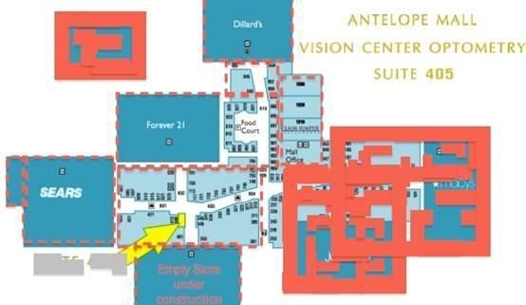
The Map of the Mall

Slide 62
Why these choices?
Why put the sick in Forever 21 you probably wonder, here is why
The sick will need a place that we know is safe for them to stay in, Sears is important because of all the tools and hardware in there. Dillards is the obvious choice to place the sick in there ,except the fact THAT IT IS RIGHT NEAR THE FOOD COURT! If the only source of food was contaminated, we would all starve to death especially if there are 300 people trapped inside. If the Empty Store is too messy, then the sick will have to live in Forever 21. We will use the rolls of plastic to cover the entrance of the sicks store and cover the vents as well, we will leave them electric powered fans for fresh air

Slide 63
How long will we have to stay in the mall?
The maximum time we would have to stay under quarantine is a "week and four days".The week will be needed to check and treat those that are sick and the four days will be used to secure that the rest of the people are safe and do not need treatment
What happens if someone dies?
In the event that someone dies we will send four people (fully geared to avoid catching the disease) to take the body and put it in a safe location(Payless or some other cheap excuse for a store) a store with freezer at least
If anybody gets infected overnight, four fully geared up people will transport them to the sick bay(where the sick are)

Slide 64
Entertainment and other needs
Each group will have a time limit to any available games or other needs for entertainment,Group Two - Four will have each only TWO hours of play, Group One will have T.V.s placed in their location of rest and have game consoles in their
For eating needs Group Two - Four will have an hour and a half to eat, Group One will have food brought to them
Each Group will have the needs to clean themselves (bathing) and have the means to brush their teeth

Slide 65
How many people will be placed in the stores?
300 students are in the mall, divide the 300 by the four stores and you get 75, but exclude the sick(counting:eighteen are to be placed) subtract that for the 300 and you get 282, divide by three and you get at 94 people evenly.
If anything else were to go wrong then it is up to the CDC to help us out, if they do not make it on time then many people will die.They have a week, if they don’t make that week then the disease will spread at a very high rate

Slide 66
How much space will be needed?
There is a width of 50000 sq feet and a height of 10ft there is enough space for the people that will be staying in the stores and there will be enough room to sleep in. There will be beds in the stores and there will be sleeping bags in the store for those that need a place to sleep
Air will be circulating regularly and we will have electric powered fans in the stores to be double sure that fresh air is circulating in the stores

Slide 67
Extra Mortality
In a scenario that 75% people get infected that will mean that 225 out of the 300 people will die; in this case, eighteen people are already infected, that means if the mortality rate is at 11% then 13-14 people will die out of the 300. But we have to also assume that they will infect one or two people [11+11+11=33]. This is IF they infect one person, and then they pass it on to another, and if they pass the disease to another, then keep adding eleven more people in the store or in a body bag.

Slide 68
Reference Page
www.google.com
www.cdc.gov
enwikipedia.org
www.ncbi.nlm.nih.gov

Slide 69
FIN

Slide 70
Lessons learned
Every stakeholder needs to have a very clear idea of exactly what their contribution to the project will be, and how it fits into the big picture.
Plan, plan, plan! Projects like this are best when they are completely planned well in advance.
The “guest lecturer” model of delivering content is most effective for groups which are not pure cohorts.
Students need more instruction on, and practice using, using online collaborative tools.

Slide 71
Lessons learned
Students need instruction giving them strategies for working effectively in groups.
Although we made no mention of including plans for entertainment, nearly every group included entertainment provisions in their presentation (even the ones who forgot to mention things like food!). Our students will include details they feel are important, even when not directed to do so. This knowledge may be useful for the future…

Slide 72
Next time?
We may choose a different topic; instead of disease, we may focus on an environmental issue, or strand them in a deserted place with all kinds of nasty hazards and a few supplies.
We will include even more teachers, utilizing the “guest lecturer” model for providing content-specific instruction.
Students will use the same rubric as instructors to evaluate their peers’ presentations and text in scores at the end of presentations.

Slide 73
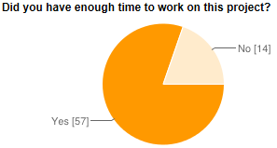
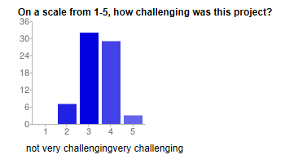
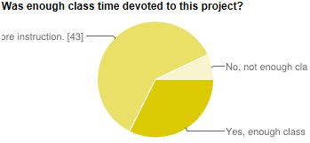
Student feedback

Slide 74
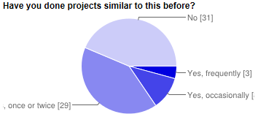
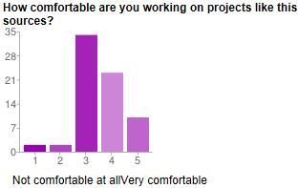
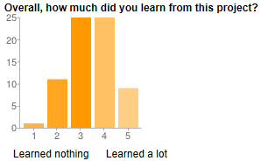
Student feedback

Slide 75
Student feedback
Trends in student feedback:
  The most noteworthy trend in positive comments was that the students liked the critical thinking involved in the project.
  Students generally appreciated working in collaborative groups.
  The number one complaint? Having to do presentations.

Slide 76
Questions?

